Slide 2
https://www.youtube.com/watch?v=QWMegbYN79I

Slide 3
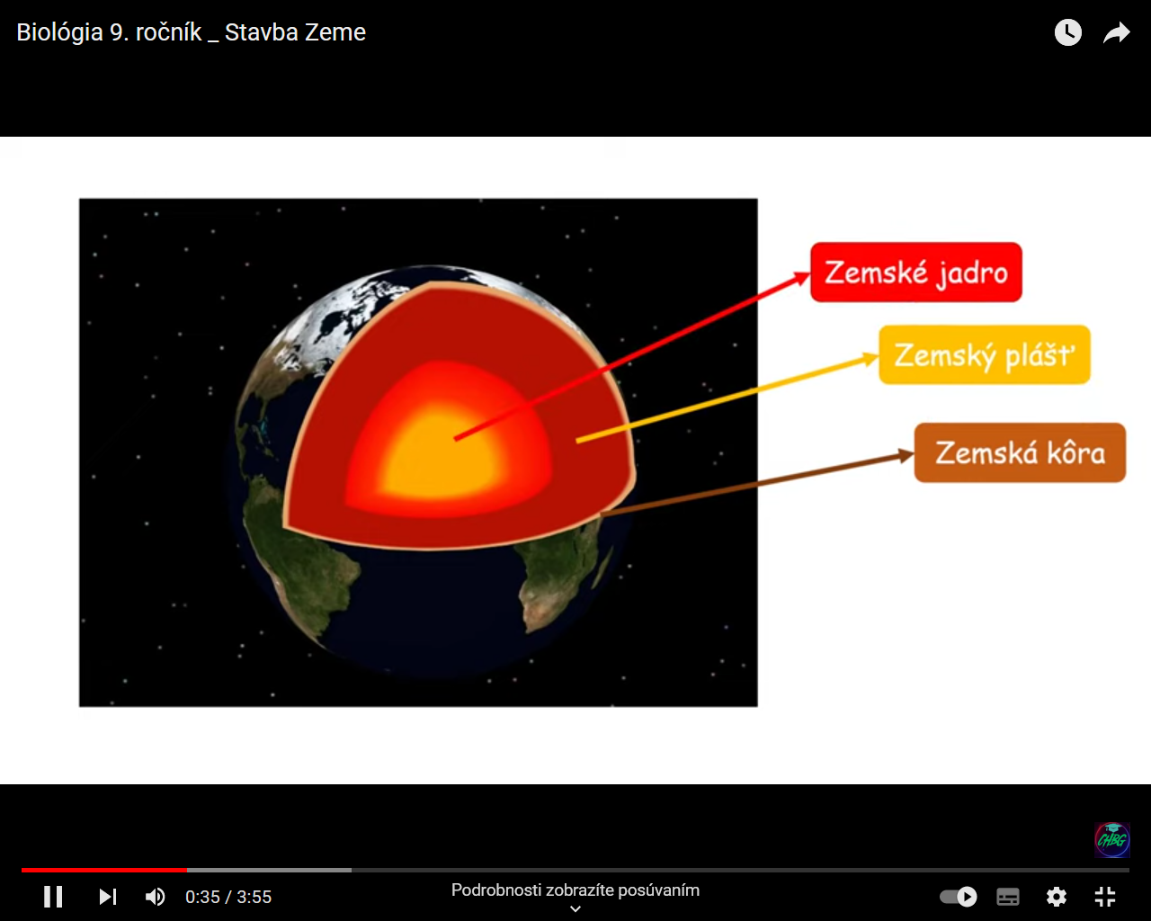

Slide 4
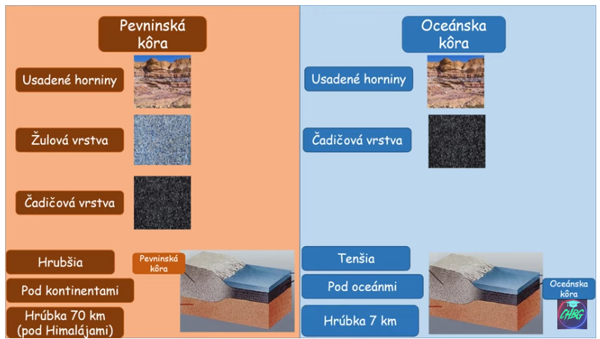

Slide 5
